Slide 1

Driver Calendar
driving service for Rand company

Slide 2
Introduction:
the new employees interface created In order to organize Rand company’s car driving .
The employees should have an account with username and password to use this service and creating requests.
Any request should be created before 30 minutes at minimum or more .
The system will send SMS for both of requester and driver before 30 minutes of the selected date and time as a confirmation or reminder through the short code: 1253.

Slide 3
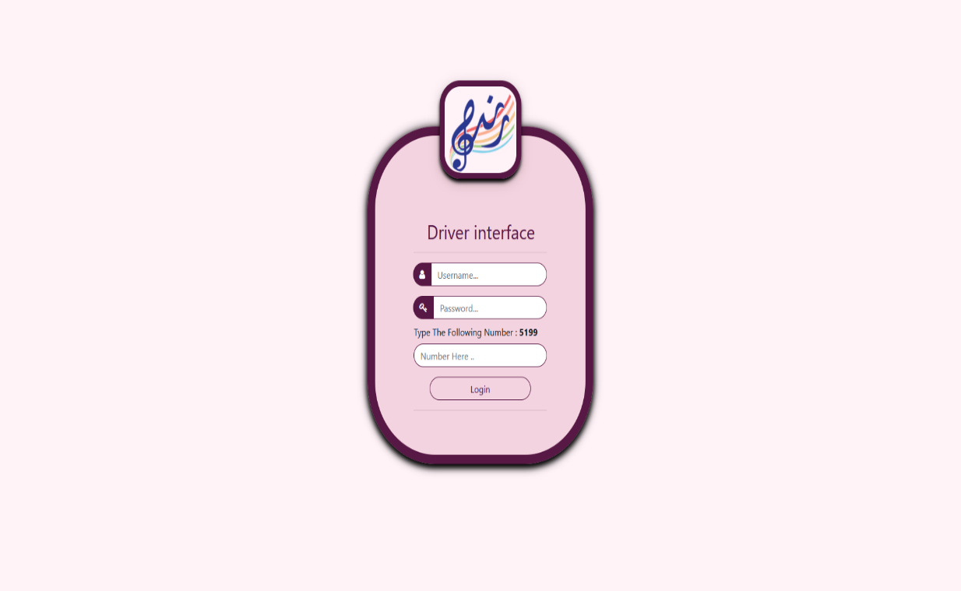
Login :
The User login through the username and password which sent to him .
and fill the code field with the appeared number.

Slide 4
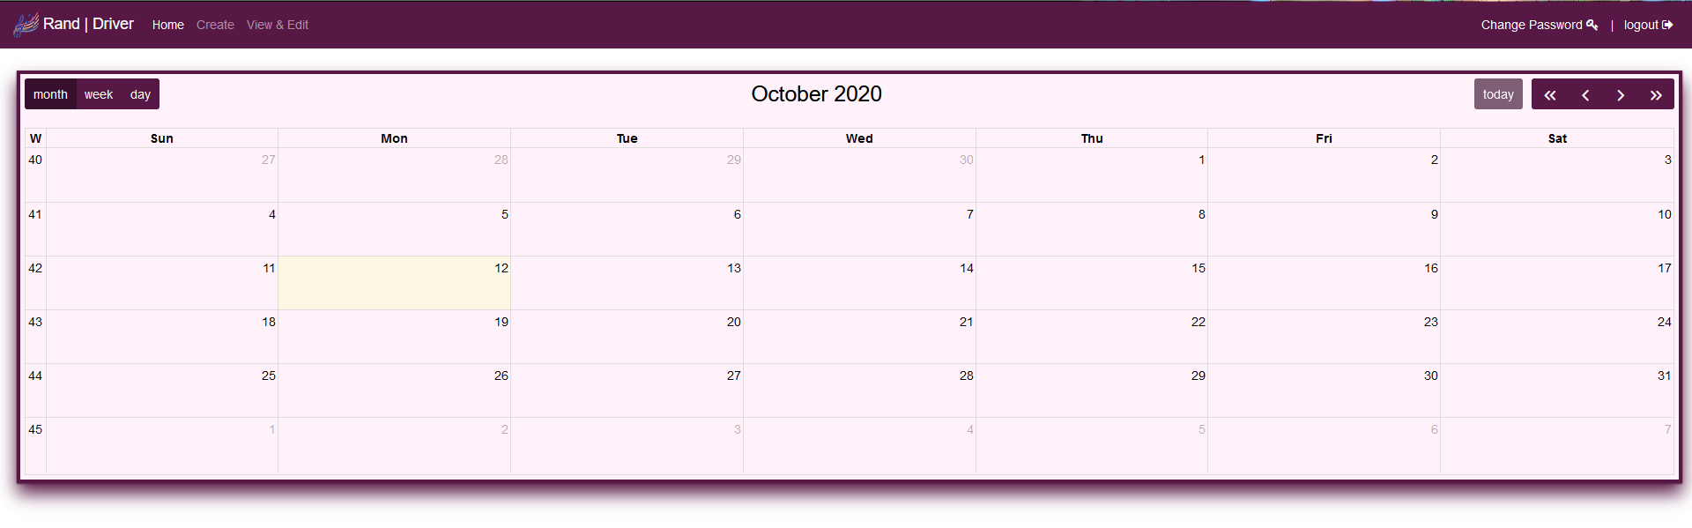
Home Tap :
User can review driver calendar as below:
1- day(date)
2- Time(from - to)
When the request approved, its appears on calendar .

Slide 5
Create request :
User sends a request for reserve a car with below inputs :
1- full name
2-mobile number
3-location
4-Date(day)
3- time(From - to)
4-Description
After sending the request successfully , the user automatically moved to view his request in View & edit page .

Slide 6
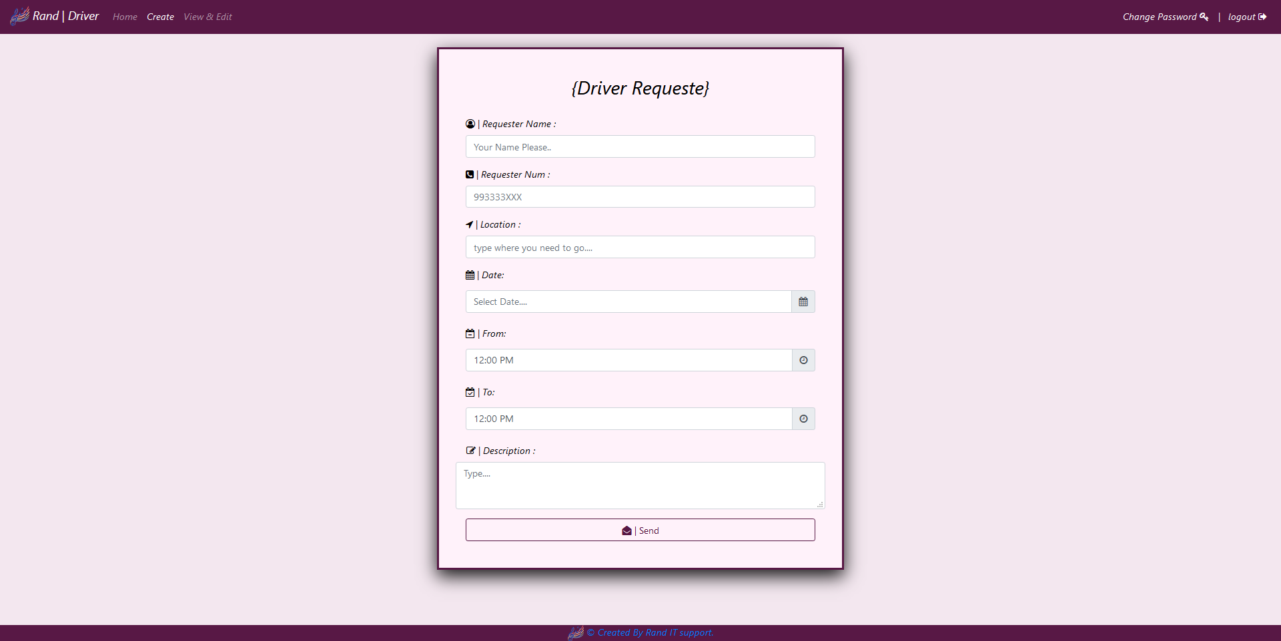
Create request Tap:
1-Your Full name
2-Your business line number
3-Your destination
4-select day
5-Short description for reason of your request

Slide 7
View and Edit Tap:
Go to view and edit page to view your submitted request and update to edit it and delete to remove it.
The requester waiting Admin’s action which will be able to approve or reject the received requests.
The requester receives an SMS before 30 minutes of the selected time contains a reminder if his request approved or rejected.

Slide 8
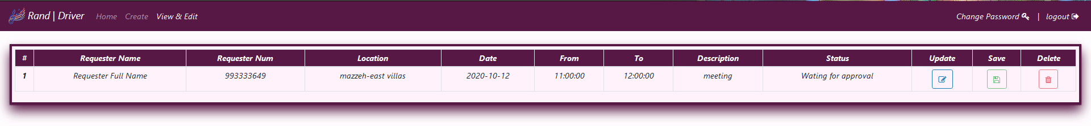
View&edit Request:
For editing any field in your request:
1-press update button
2-make changes on fields which you want
3-press save button

Slide 9
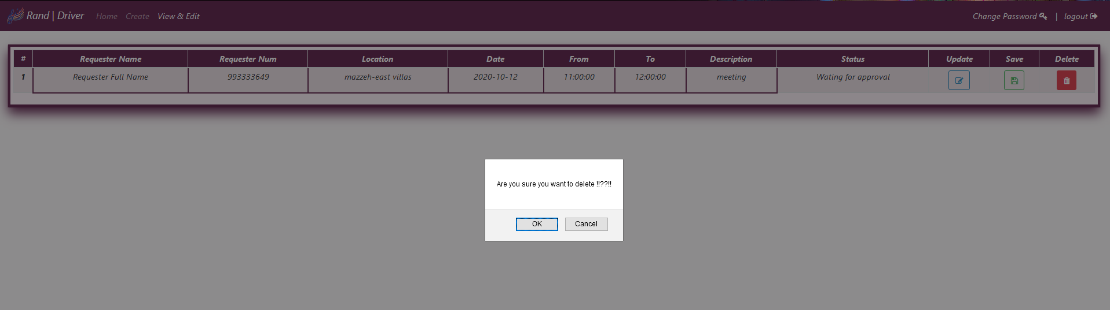
Delete request:
For delete your request:
1-press update button
2-press delete button
3-confirm deleting

Slide 10
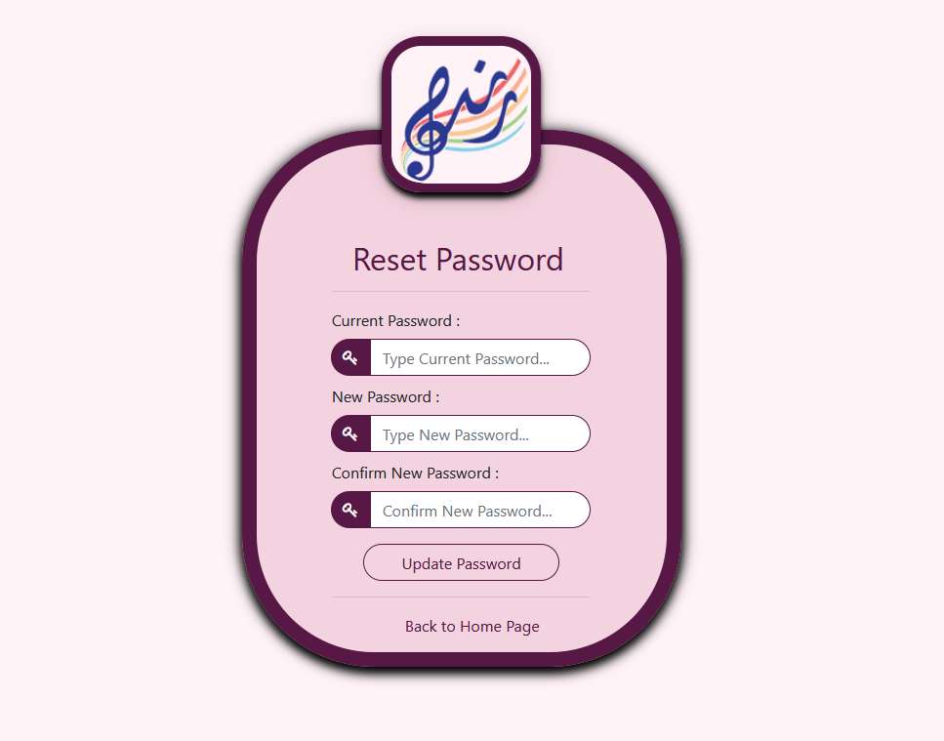
Change password Tap :
After updating your password, you must login again with your new password.

